Slide 1


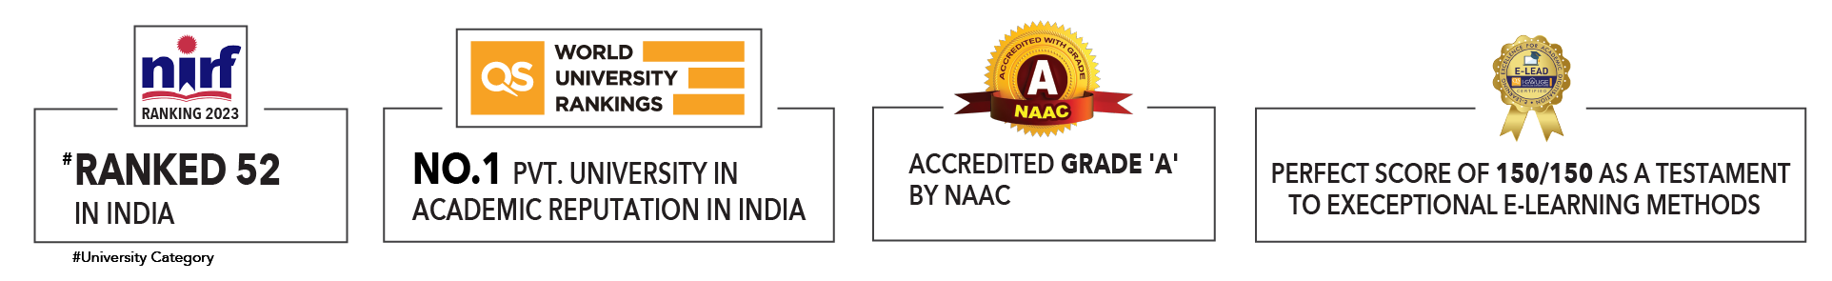

Slide 2

Unit 4 : Types of machine learning
Lecture 1: Introduction to Machine Learning Techniques
School of Computer Science UPES, Dehradun
India

Slide 3
Table of Contents
Introduction to machine learning
Types of ML
Classification in supervised machine
Regression in supervised machine learning
Types of ML
Machine Learning Life cycle
Applications of Machine Learning
Benefits of Machine Learning

Slide 4
Learning & Course Outcomes
LO1: Understand and explain the basic concepts and terminology of machine learning, including supervised learning, unsupervised learning, reinforcement learning, features, labels, and datasets.
LO2: Differentiate between various types of machine learning algorithms (e.g., classification, regression, clustering, and dimensionality reduction) and identify appropriate use cases for each.
LO3:Understand the theoretical foundations of common machine learning algorithms.
CO1: Understand the basic concepts and techniques of Artificial Intelligence.
CO2: Understand the basics of Machine Learning and its types.

Slide 5
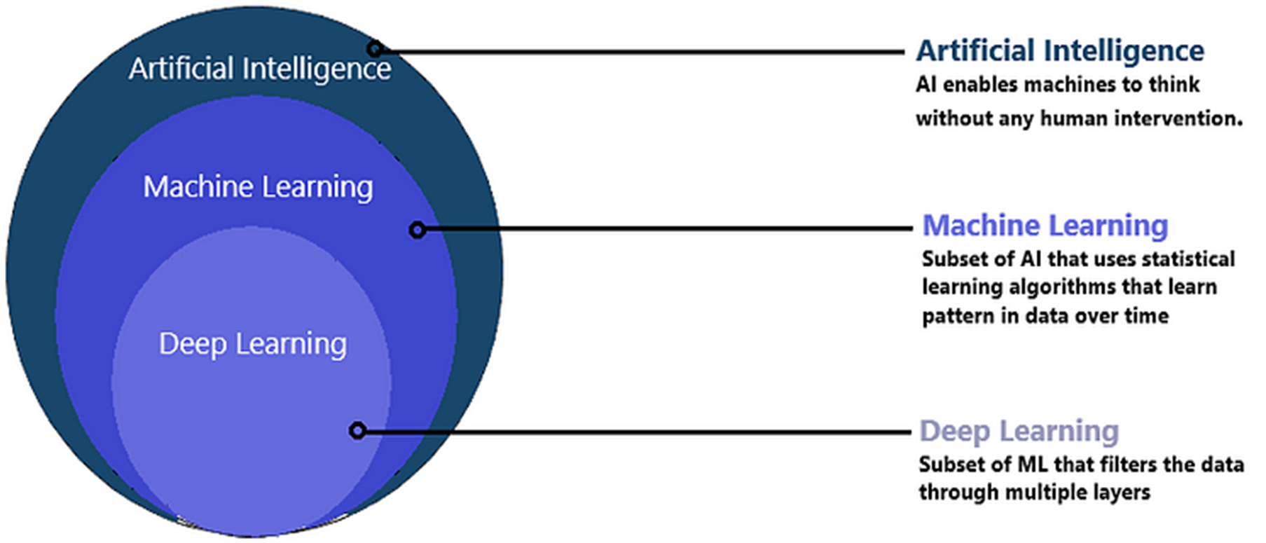
Machine Learning
Artificial Intelligence is purely math and scientific exercise but when it becomes computational, it starts to solve human problems.
Machine Learning is a subset of Artificial Intelligence.
Figure: 1

Slide 6
Machine Learning
The term machine learning was first coined in the 1950s when Artificial Intelligence pioneer Arthur Samuel built the first self-learning system for playing checkers.
ML involves the development of algorithms and statistical models that enable computers to improve their performance in tasks through experience.
ML explores the study and construction of algorithms that can learn from data and make predictions on data.
Based on more data, machine learning can change actions and responses which will make it more efficient, adaptable, and scalable.

Slide 7
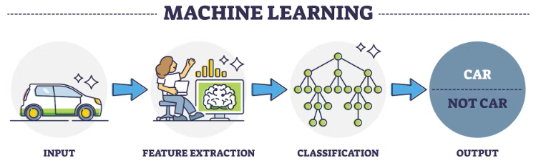
Machine Learning
ML algorithms are able to detect patterns in data and learn from them, in order to make their own predictions. In short, ML algorithms and models learn through experience.
Today, ML is everywhere ‒ automated translation, image recognition, voice search technology, self-driving cars, and beyond.
Figure: 2

Slide 8
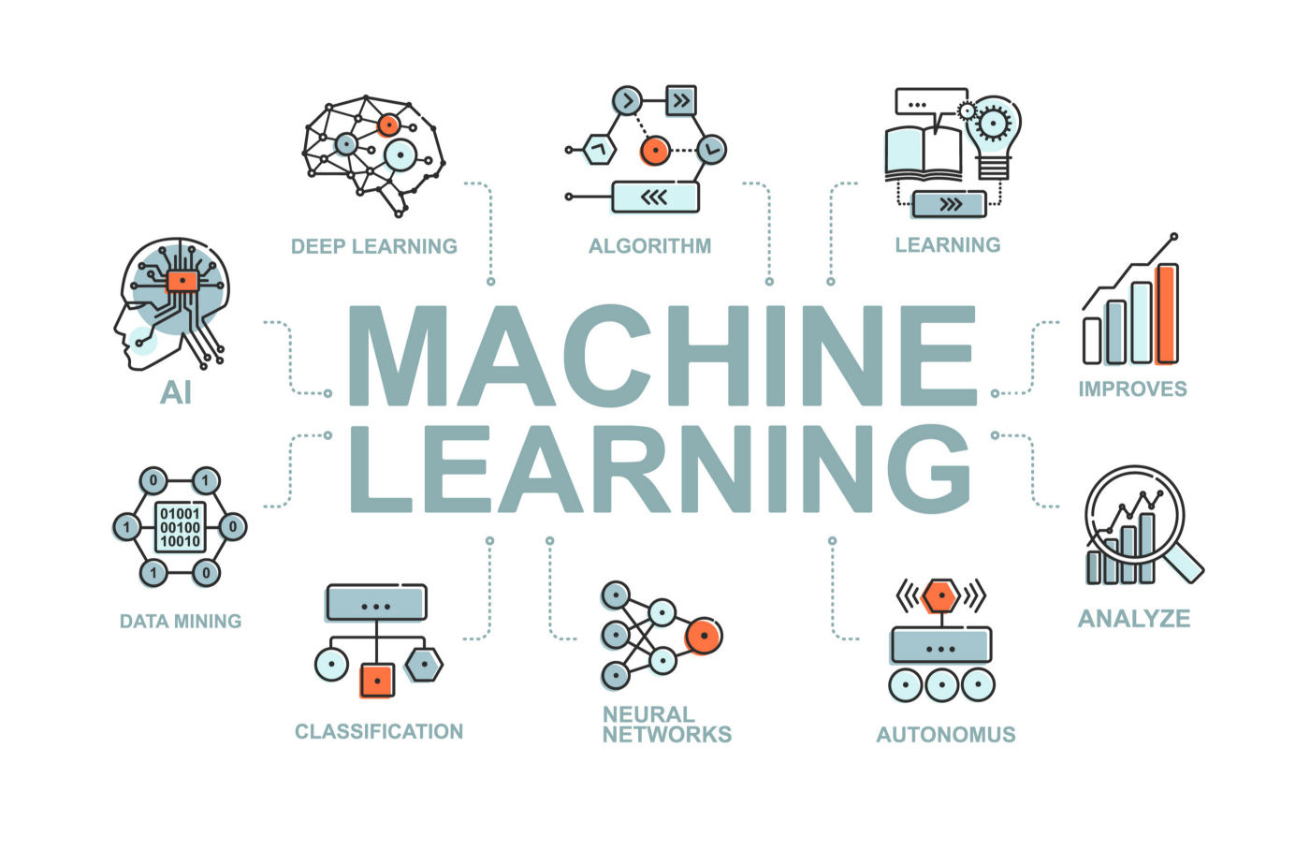
Machine Learning
Figure: 3

Slide 9
Machine Learning
In traditional programming, a computer engineer writes a series of directions that instruct a computer how to transform input data into a desired output.
Instructions are mostly based on an IF-THEN structure: when certain conditions are met, the program executes a specific action.
ML is an automated process that enables machines to solve problems with little or no human input, and take actions based on past observations.
While AI and ML are often used interchangeably, they are two different concepts.
AI is the broader concept – machines making decisions, learning new skills, and solving problems in a similar way to humans.
Whereas machine learning is a subset of AI that enables intelligent systems to autonomously learn new things from data.
Machine learning can be put to work on massive amounts of data and can perform much more accurately than humans.

Slide 10
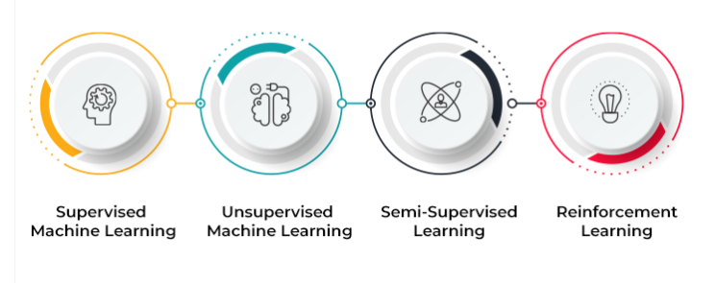
Types of ML
Figure: 5

Slide 11
Types of ML
ML implementations are classified into four major categories, depending on the nature of the learning “signal” or “response” available to a learning system which are as follows:
Supervised learning: training a model on labeled data
Unsupervised learning: training a model on unlabeled data
Reinforcement learning: training a model through trial and error
Semi-supervised learning: falls between unsupervised learning and supervised learning.

Slide 12
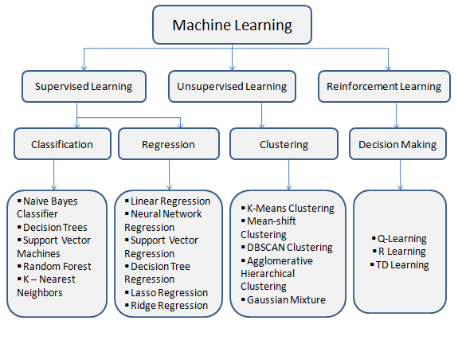
Types of ML

Slide 13
Types of ML
Supervised learning is the ML task of learning a function that maps an input to an output based on example input-output pairs.
The given data is labeled.
Both classification and regression problems are supervised learning problems.
Example — Consider the following data regarding patients entering a clinic . The data consists of the gender and age of the patients and each patient is labeled as “healthy” or “sick”.
Gender | Age | Label
Male | 48 | Healthy
Female | 20 | Sick
Male | 47 | Sick
Female | 50 | Healthy
Female | 55 | Sick
Male | 39 | Sick
Male | 47 | Healthy

Slide 14
Types of ML
A supervised learning algorithm analyzes sample data and makes an inference – basically, an educated guess when determining the labels for unseen data.
This is the most common and popular approach to machine learning.
It’s “supervised” because these models need to be fed manually tagged sample data to learn from.
Data is labeled to tell the machine what patterns (similar words and images, data categories, etc.) it should be looking for and recognize connections with.
For example, if we want to automatically detect spam, we need to feed a machine learning algorithm examples of emails that we want classified as spam and others that are important, and should not be considered spam.
The two types of supervised learning tasks: classification and regression.

Slide 15
Types of ML
In classification, the goal is to predict a class label, which is a choice from a predefined list of possibilities
In regression, the goal is to predict continuous number, or a floating-point number in programming terms (or real number in mathematical terms). E.g, predicting a person annual income from their education, age, where they live

Slide 16
Classification in supervised machine
There are a number of classification algorithms used in supervised learning, with Support Vector Machines (SVM) and Naive Bayes among the most common.
In classification tasks, the output value is a category with a finite number of options.
For example, in a pre-trained sentiment analysis model, we can automatically classify data as positive, negative, or neutral.
Regression in supervised machine learning
In regression tasks, the expected result is a continuous number.
This model is used to predict quantities, such as the probability an event will happen, meaning the output may have any number value within a certain range.
Predicting the value of a property in a specific neighborhood or the spread of COVID19 in a particular region are examples of regression problems.

Slide 17
Types of Classification Algorithms
Naive Bayes classifier
Decision Trees
Logistic Regression
K-Nearest Neighbours
Support vector machine
Random forest classification
Types of Regression Algorithms
Simple linear Regression
Multiple linear Regression
polynomial Regression
Decision Tree Regression
Random forest Regression
Ensemble Method

Slide 18
Types of ML
Unsupervised learning is a type of machine learning algorithm used to draw inferences from datasets consisting of input data without labeled responses.
In unsupervised learning algorithms, classification or categorization is not included in the observations.
Example: Consider the following data regarding patients entering a clinic. The data consists of the gender and age of the patients.
Gender | Age
Male | 48
Female | 20
Male | 47
Female | 50
Female | 55
Male | 39
Male | 47

Slide 19
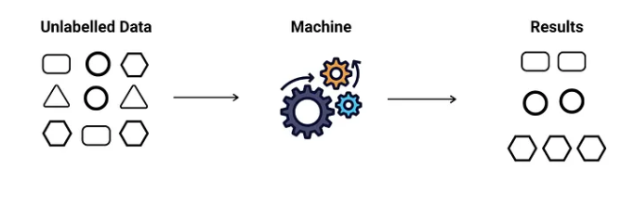
Types of ML
As a kind of learning, it resembles the methods humans use to figure out that certain objects or events are from the same class, such as by observing the degree of similarity between objects.
Some recommendation systems that you find on the web in the form of marketing automation are based on this type of learning.
Types of Unsupervised Learning
Clustering
Anomaly detection
Association
Auto-encoders
Latent variable models
Neural Networks
Figure: 6

Slide 20
Types of ML
Reinforcement learning is the problem of getting an agent to act in the world so as to maximize its rewards.
A learner is not told what actions to take as in most forms of machine learning but instead must discover which actions yield the most reward by trying them.
Example: Consider teaching a dog a new trick: we cannot tell him what to do, what not to do, but we can reward/punish it if it does the right/wrong thing.
When watching the video, notice how the program is initially clumsy and unskilled but steadily improves with training until it becomes a champion.

Slide 21
Types of ML
Semi-supervised learning is an approach to machine learning that combines small labeled data with a large amount of unlabeled data during training.
Where an incomplete training signal is given: a training set with some (often many) of the target outputs missing.
In Semi-supervised learning model uses labeled data as an input to make inferences about the unlabeled data, providing more accurate results than regular supervised-learning models.
There is a special case of this principle known as Transduction where the entire set of problem instances is known at learning time, except that part of the targets are missing.
Semi-supervised learning doesn’t require a large number of labeled data, so it’s faster to set up, more cost-effective than supervised learning methods, and ideal for businesses that receive huge amounts of data.

Slide 22
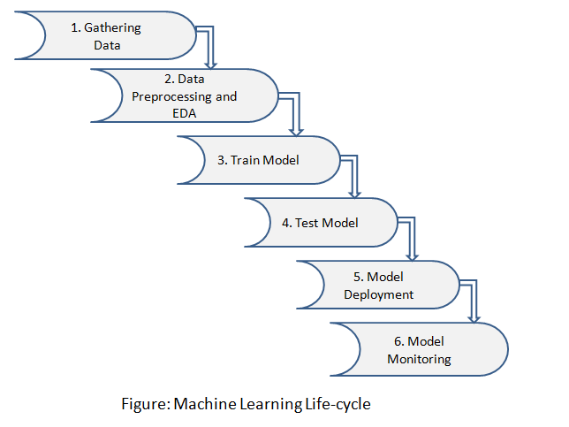
Machine Learning Life cycle
Machine Learning helps to increase the performance and productivity of the task. It includes learning and self-correction when introduced with new data.
Figure: 7

Slide 23
Machine Learning Life cycle
Machine Learning lifecycle involves six major steps:
Step 1: Gathering Data
Identify various data sources such as Kaggle and collect the required dataset
Step 2: Data Preprocessing and EDA
In this step, we do an analysis of the data for missing values, duplicate data, invalid data using different analytical techniques. And also preprocessing the data for feature extractions, feature analysis, and data visualization.
Step 3: Train Model
We use a dataset to train the model using various machine learning algorithms. Training a model is important so that it can understand the various patterns, rules, and features.
Step 4: Test Model
In this step, we check for the accuracy of our model by providing a test dataset to the trained model.

Slide 24
Machine Learning Life cycle
Step 5: Model Deployment
Model deployment means integrating a machine learning model into an existing production environment that takes input and returns output to make business decisions based on data.
Various technologies that you can use to deploy your machine learning models are listed:
Docker
Kubernetes
AWS SageMaker
MLFlow
Azure Machine Learning Service
Step 6: Model Monitoring
After deployment of the model here comes model monitoring which monitors your machine learning models for factors like errors, crashes, and latency and most importantly to ensure that your model is maintaining the desired performance.

Slide 25
Applications of Machine Learning
Real-World Applications of Machine Learning
Automatic Language Translation in Google Translate
Faster route selection in Google Map
Driverless/Self-driving car
Smartphone with face recognition
Speech Recognition
Ads Recommendation System
Netflix Recommendation System
Auto friend tagging suggestion in Facebook
Stock market trading
Fraud Detection
Weather Prediction
Medical Diagnosis
Chatbot
Machine Learning in Agriculture

Slide 26
Benefits of Machine Learning
Benefits of machine learning
Work Automation
Powerful predictive Ability
Increased in sales in the e-commerce market
ML benefits in the medical domain for enhancing medical diagnosis, drug development
Machine Learning is used in robotic medical surgery
ML in finance increases productivity enhances revenue and gives secure transactions
Modeling the data to make useful decisions

Slide 27

Machine Learning
Relationship between variables: Correlation
The relationship between variables is identified in a scatter plot.
The numerical representation of the relationship is given by correlation. Correlation gives the degree and strength of the relationship between variables. It could be positive or negative (between -1 and +1).
If the correlation coefficient is 0, it means there is no relationship between variables.
Correlation should be performed for numeric variables only.
Pearson’s correlation coefficient
$$r=\sum{{(x_{i}−\overline{x})(y_{i}−\overline{y})}/{\sqrt{\sum{{(x_{i}−\overline{x})}^{2}\sum{{(y_{i}−\overline{y})}^{2}}}}}}$$
Where “r” is the correlation coefficient,
e.g.
1. Correlation between age and experience will be positive
2. Correlation between expenses and profit in an organization are negatively corelated.

Slide 28
Machine Learning
Two Major classification of machine learning algorithms are:
Supervised learning algorithm
Regression
Classification
Unsupervised learning algorithm
Clustering
Association Rule Mining
Supervised learning:
In this, develop a model under the presence of supervisor. The supervisor is the input data that are labelled. In a labelled dataset, the outputs are known already.
In a supervised learning algorithm, the input features are called independent or predictor variables. The output features are called as dependent or response variable.

Slide 29
Machine Learning
Supervised learning:
Regression: It is a technique for determining the statistical relationship between two or more variables.
Regression ML is applied when the output variable is numeric and has a continuous value.
The value of output variable varies with changes in the input/predictor variables.
Classification: Used to classify the category of the response variable.
The objective of a classification algorithm is to accurately predict the target class for each observation in the dataset.

Slide 30
Machine Learning
Unsupervised learning
Association Rule Mining:
Association rules find rule based relationships among data points from large transaction databases. They help to identify frequently occurring patterns and discover interesting associations to find out the sequences that exist between variables.
The output from this algorithm gives the sequence of order of transactions.
e.g, Web traffic analysis, the sequence of webpages visited by the users can be found out using sequence mining.
The algorithm identifies the relationships in databases by applying three important measures such as support, confidence, and lift, to generate association rules.

Slide 31
Machine Learning
Support:
Frequency of occurrence of the two itemset in the transaction database.
It is essential to understand the meaning of an itemset. The support of a->b indicates the number of times “a” and “b” occur together in the transaction dataset.
Support(a->b)=Number of transaction in which “a” and “b” occur together/ Total number of transaction.
Support(Milk->Butter)= Number of transaction in which “Milk” and “Butter” occur together/ Total number of transaction.
=5/10=50%

Slide 32
Machine Learning
Itemset:
In a transaction dataset i={a,b,c,…,z}, where a, b, and c are the items. The output of an association rule mining algorithm is an association rule represented by a->b, which indicates that when “a” happens “b” also happens.
Here, “a” refers to as the rule antecedent and “b” is referred to as the rule consequent.
E.g. Suppose milk and butter are the items of the dataset and the rule indicates that when a customer buy milk they also buy butter.
Here, “milk” is referred to as the rule antecedent, meaning milk is bought first, and “butter” is the rule consequent, meaning if customers buy milk, they will also buy butter.

Slide 33
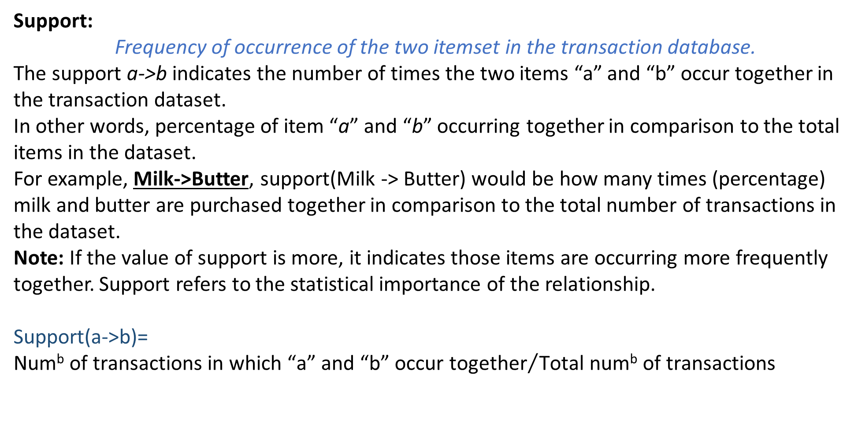
Machine Learning
Support:
Frequency of occurrence of the two itemset in the transaction database.
The support a->b indicates the number of times the two items “a” and “b” occur together in the transaction dataset.
In other words, percentage of item “a” and “b” occurring together in comparison to the total items in the dataset.
For example, Milk->Butter, support(Milk -> Butter) would be how many times (percentage) milk and butter are purchased together in comparison to the total number of transactions in the dataset.
Note: If the value of support is more, it indicates those items are occurring more frequently together. Support refers to the statistical importance of the relationship.
Support(a->b)= ${\text{Num}\text{b} \text{of} \text{transactions} \text{in} \text{which}\text{ “}\text{a}\text{” }\text{and}\text{ “}\text{b}\text{” }\text{occur} \text{together}}/{\text{Total} \text{numb} \text{of} \text{transactions}}$

Slide 34

Machine Learning
Support:
Support(Milk -> Butter)=
$${\text{Num}\text{b} \text{of} \text{transaction} \text{in} \text{which}\text{ “}\text{milk}\text{” }\text{and}\text{ “}\text{butter}\text{” }\text{occur} \text{together}}/{\text{Total} \text{numb} \text{of} \text{transactions}}$$
Support(Milk -> Butter) = 5/10 =50%
Confidence:
Measures the statistical strength of the association rule. It is the conditional probability of the occurrence of the event.
Confidence(a->b)= Num^{b} of transactions in which “a” and “b” occur together/ num^{b} of transactions in which “a” occurs.
Or
Confidence(a->b)= Support(a->b)/ Support(a)

Slide 35

Machine Learning
Lift:
It referred to as an interestingness measure.
Note:
a. Lift value equal to 1 means the two items have no correlation.
b. Lift value less than 1 shows substitution effect, means two items are never bought together.
c. Lift value greater than 1 indicates a complementary effect, which means the two items are aways bought together.
$$\text{Lift}\text{(}\text{a}\text{−>}\text{b}\text{)=} \frac{\text{Num}\text{b} \text{of} \text{transactions} \text{in} \text{which}\text{ “}\text{a}\text{” }\text{and}\text{ “}\text{b}\text{” }\text{occur} \text{together}}{\text{num}\text{b} \text{of} \text{transactions} \text{in} \text{which}\text{ “}\text{a}\text{” }\text{occurs}\text{ ∗ }\text{numb} \text{of} \text{transactions} \text{in} \text{which}\text{ “}\text{b}\text{” }\text{occurs}}$$
Or
Lift(a->b)= Support(a->b)/ Support(a)* Support(b)

Slide 36

Thank You

